Slide 1
Artificial Intelligence And machine learning
Customer Churn Prediction
Faculty Coordinator: Team Details:
Dr. Monica Dutta Mann Sharma (2210990555)
Mridul Goyal (2210990584)
Mohd Ishaan (2210990581)
Nishant Dinesh R. (221090617)
:
Chitkara University Institute of Engineering and Technology,
Chitkara University, Punjab

Slide 2
CONTENTS
Problem Statement
Objective
EDA
Tools Used
Data Summary
Exploratory Data Analysis
Conclusions
Result

Slide 3

Problem Statement
The Customer Churn Prediction EDA project aims to explore data attributes such as customer demographics, account information, and service usage patterns to understand factors influencing customer retention.
By leveraging Exploratory Data Analysis techniques, the project seeks to uncover hidden patterns and relationships that help businesses make informed decisions to reduce churn and improve customer loyalty.
The project will involve data preprocessing to
clean and prepare the data, feature engineering
to create meaningful variables, and the
evaluation of different classification algorithms.
These steps are designed to build effective predictive models that accurately forecast customer churn.
Ultimately, the project aspires to deliver actionable insights and recommendations that businesses can use to enhance customer loyalty and minimize churn, thereby improving their overall customer retention strategy.

Slide 4
OBJECTIVE
1. Explore Data Attributes: Examine customer demographics, account information, and service usage patterns to understand factors influencing customer retention.
2. Leverage EDA Techniques: Utilize Exploratory Data Analysis to uncover hidden patterns and relationships in the data.
3. Data Preprocessing: Clean and prepare the data for analysis to ensure accuracy and consistency.
4. Feature Engineering: Create meaningful variables that enhance the predictive power of the model.
5. Evaluate Classification Algorithms: Assess different classification algorithms to identify the most effective methods for predicting customer churn.
6. Develop Predictive Models: Build models that accurately forecast customer churn and provide actionable insights.
7. Provide Recommendations: Offer data-driven recommendations for businesses to enhance customer loyalty and reduce churn rates.

Slide 5
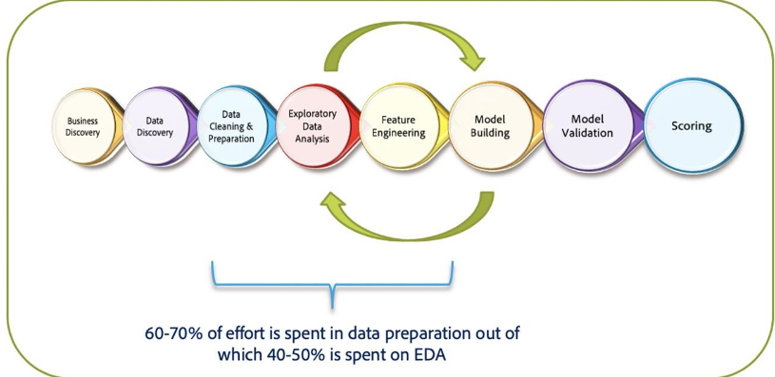
Exploratory Data Analysis
Exploratory Data Analysis (EDA) refers to the method of studying and exploring record sets to apprehend their predominant traits, discover patterns, locate outliers, and identify relationships between variables. EDA is normally carried out as a preliminary step before undertaking extra formal statistical analyses or modeling.

Slide 6
Tools used
1. Jupyter Notebook used as IDE.
2. Pandas and NumPy are used for Data Manipulation & Pre-processing and Mathematical functions respectively.
3. Exploratory data analysis is automated by data prep.
4. For visualization of the plots, Matplotlib, Seaborn, Plotty are used.

Slide 7

Data Summary
Numerical Data
CustomerID
Churn
Tenure
Citytier
Warehousetohome
HourSpendOnapp
NumberOfDeviceRegister
SatisficationScore
NumberOfAdress
Complain
OrderAmountHikesFromLastyear
CouponUsed
OrderCount
DaySinceLastOrder
CashbackAmount
Categorical Data
1. PreferredLoginDevice
2. PreferredPaymentMode
3. Gender
4. PreferredOrderCat
MartialStatus

Slide 8
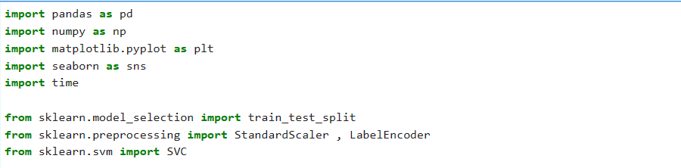
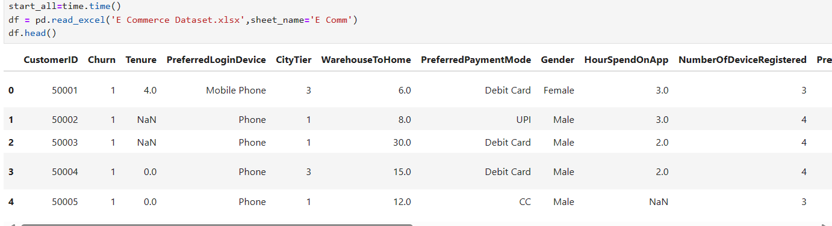
Data Summary
This is the Customer Churn Prediction dataset. In the below table it shows the top 5 rows.

Slide 9
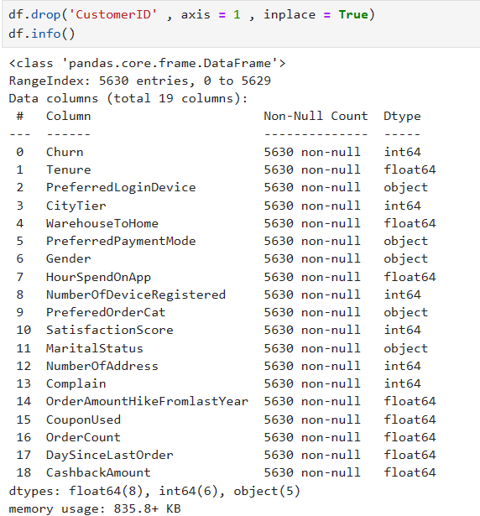
Data Summary
No column includes null or missing values

Slide 10
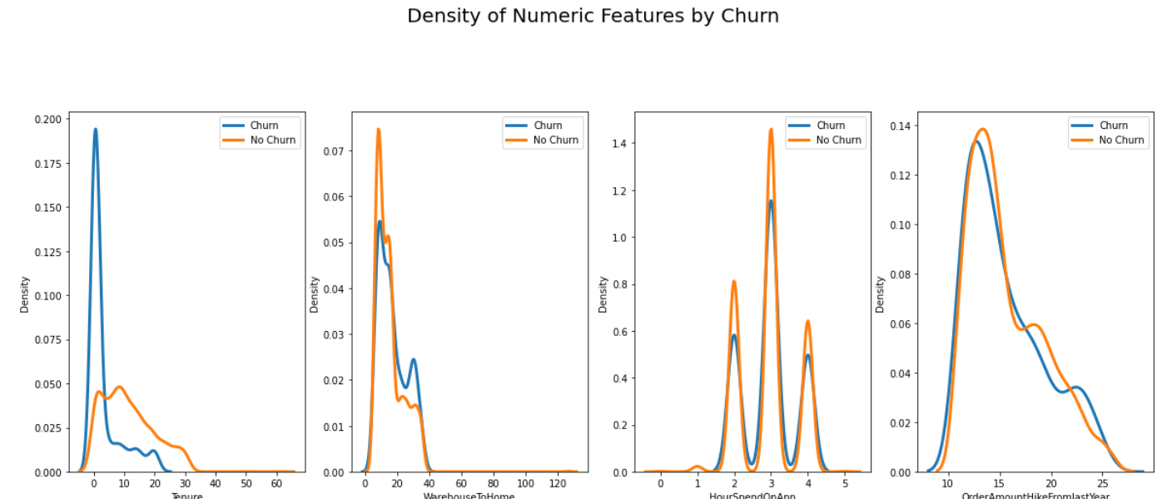
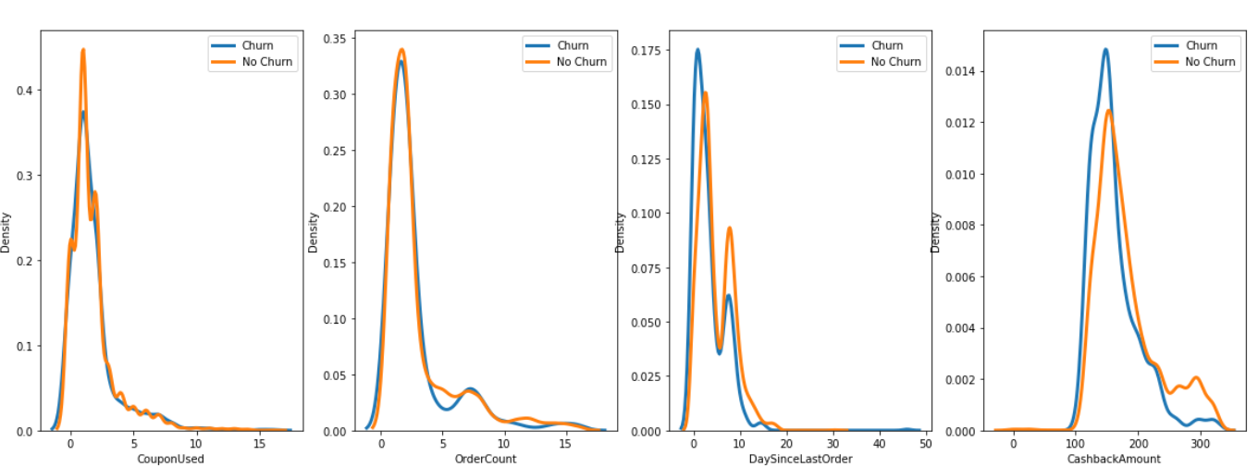
Density of Numeric Feature’s by Churn

Slide 11
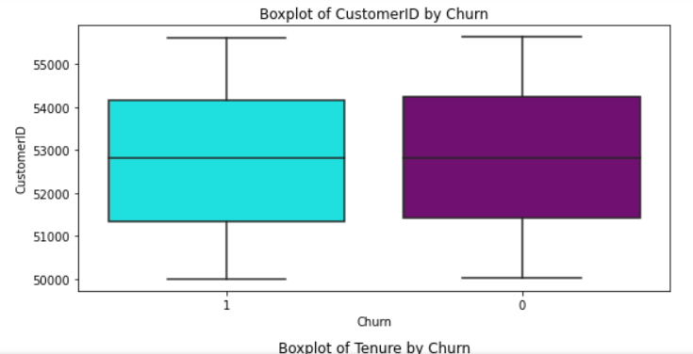
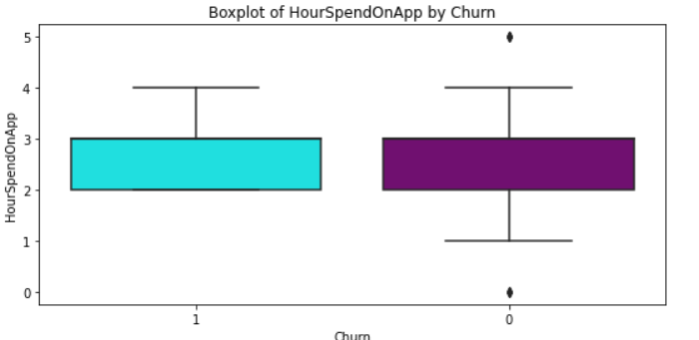
BoxPlot of Numeric Feature’s by Churn
1. A box plot is selected to understand the distribution of Flat prices based on the number of bedrooms so that the outliers can be found.
2. Unlike a box plot that can only show summary statistics, violin plots depict summary statistics and the density of each variable.

Slide 12
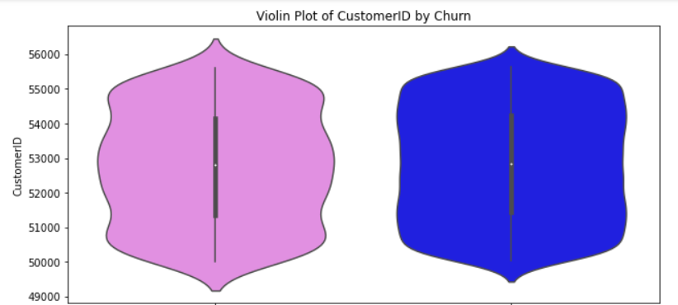
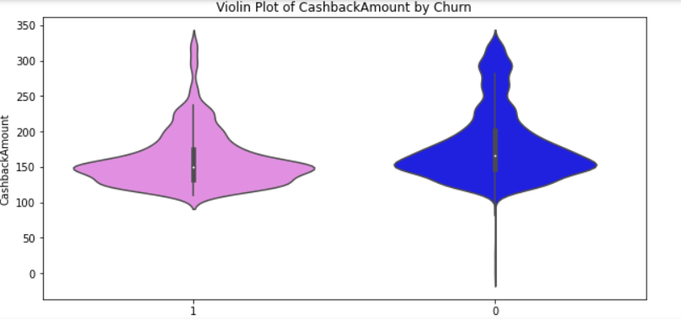
Violin Plot of Numeric feature’s by Churn
A Violin Plot is a method to visualize the distribution of numerical data of different variables. It combines elements of box plots and kernel density plots, providing a detailed view of data distributions.

Slide 13
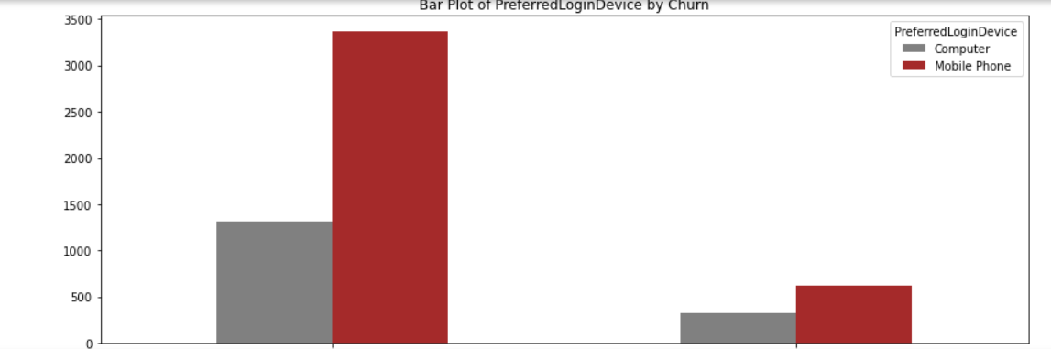
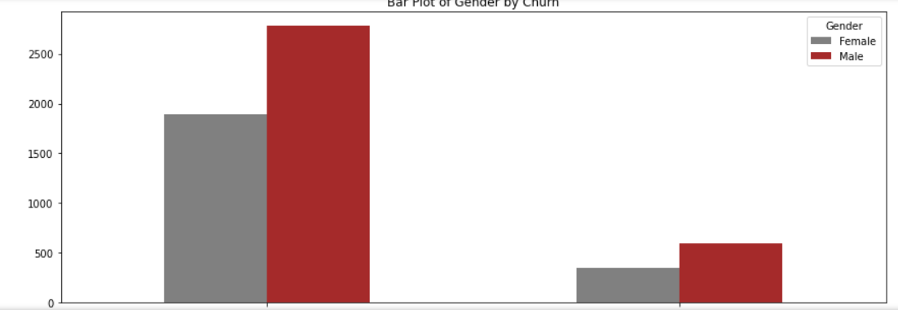
Bar Plots of Categorical Feature’s
A Bar Plot is a graphical representation of data that uses rectangular bars to compare categories of data

Slide 14
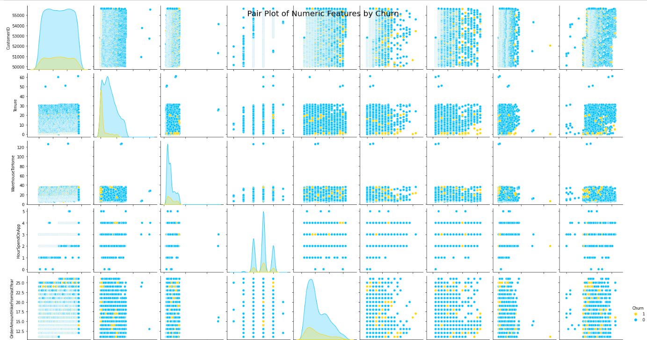
Pair Plot of Numeric feature’s
A Pair Plot, also known as a scatterplot matrix, is a matrix of graphs that enables the visualization of the relationship between each pair of variables in a dataset. It combines both histogram and scatter plots, providing a unique overview of the dataset’s distributions and correlations.

Slide 15
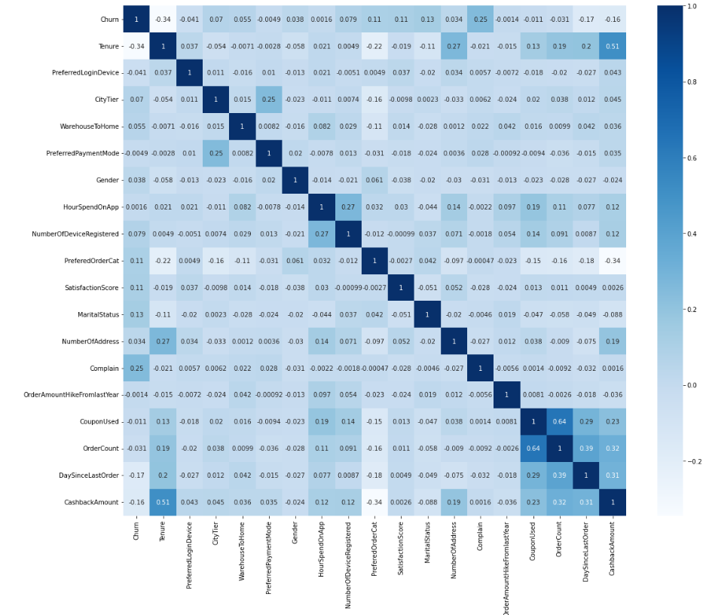
Heatmap
A Heatmap is a powerful data visualization tool that provides a visual representation of data values in a matrix.

Slide 16
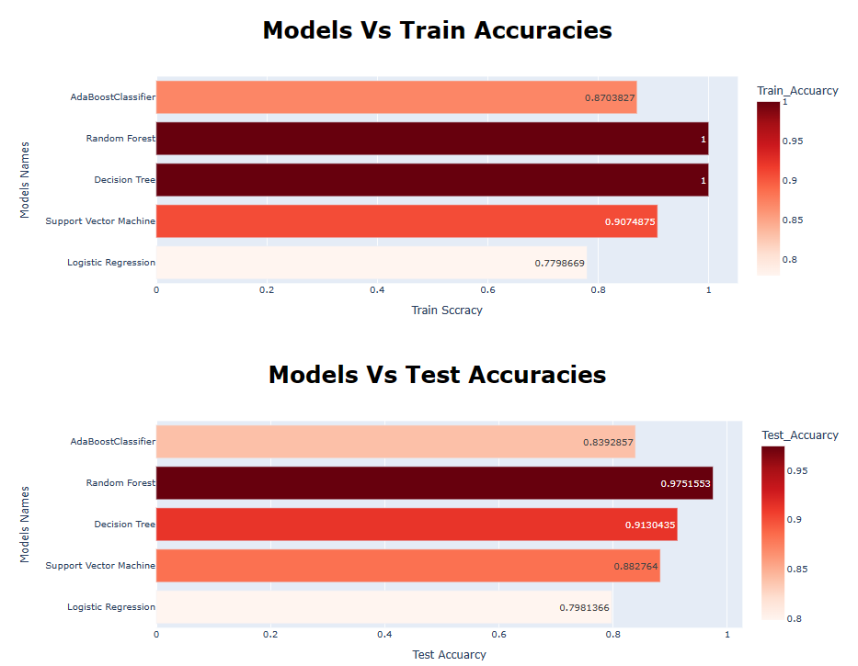
Classification
1. AdaBoost is a boosting algorithm that combines multiple weak classifiers to form a strong classifier.
2. Random Forest is a supervised learning algorithm that combines the output of multiple decision trees to reach a single result.
3. A Decision Tree is a non-parametric supervised learning algorithm used for both classification and regression tasks3.
4. A Support Vector Machine (SVM) is a supervised learning algorithm that classifies data by finding an optimal line or hyperplane that maximizes the distance between each class in an N-dimensional space.
5. Logistic Regression is a supervised learning algorithm used in classification problems where we have to distinguish the dependent variable between two or more categories or classes by using the independent variables

Slide 17
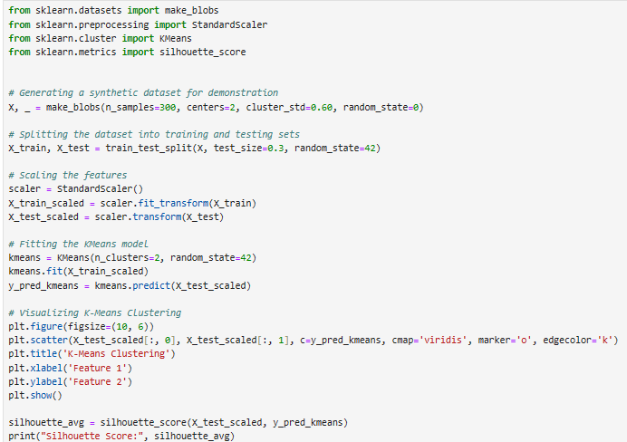
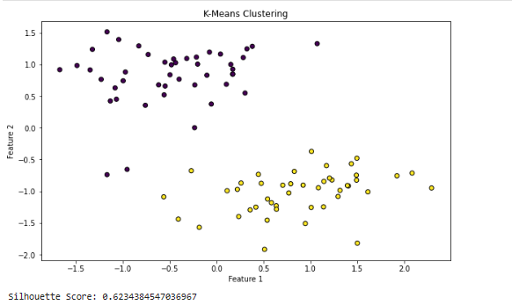
K-means Clustering
K-Means Clustering groups unlabeled data into clusters using centroids, iteratively
updating them for optimal clustering.

Slide 18
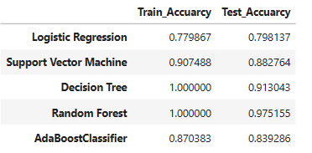

Result

Slide 19
Conclusion
The AI model for predicting customer churn utilized algorithms like Random Forest,
AdaBoost, SVM, Logistic Regression, Decision Tree, and K-Means Clustering.
Each algorithm’s unique strengths enhanced the model’s robustness and accuracy.
This diverse approach effectively predicted churn, providing comprehensive insights
for devising customer retention strategies.

Slide 20


